Slide 1
AOSP Apps Investigations
Part 2: Investigating contacts management service
Notes:
https://android.googlesource.com/platform/packages/providers/ContactsProvider/+/b0f94c82189fdbe30037fbda532576043cbb067e/src/com/android/providers/contacts/ContactsProvider.java

Slide 2
Contact management services

Slide 3
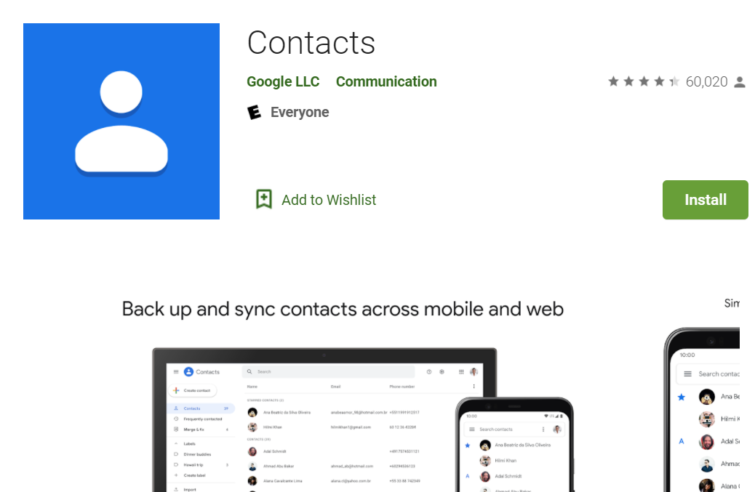
What are the contact management services?
It is responsible for managing the device's contact information
names,
phone numbers,
and emails.
In Android, apps and services are identified by unique package names
com.android.providers.contacts

Slide 4
Features
Keep your contacts organized and up to date
View your contacts by account (e.g., work vs. personal)
Easily add contacts and edit information like phone numbers, emails, and photos
Get suggestions for adding new contacts, merging duplicates, and more
Back up your contacts and sync them across all your devices
Safely back up the contacts in your Google Account to the cloud
Access the contacts in your Google Account from any device
Record calling logs
Provides content providers that the third-party app can use to manipulate Android contacts

Slide 5
Why it's important to investigate contacts management service?
Contacts: Understand the device owner’s social network
Contact profile
groups information
Call logs: Understand owner’s calling history
Who made the call
Was it received or not
Duration of the call
Voicemails: Know who contacted the owners and the conversation
can retrieve the stored message through phone, desktop, email and other communications devices

Slide 6
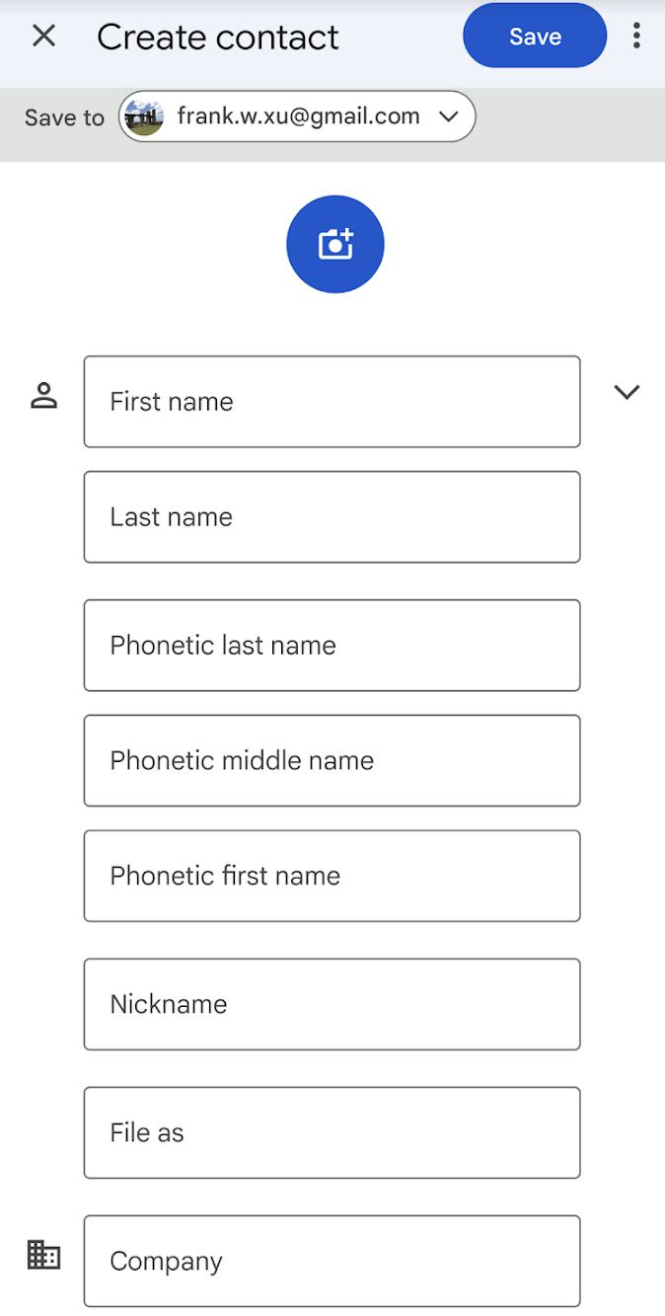
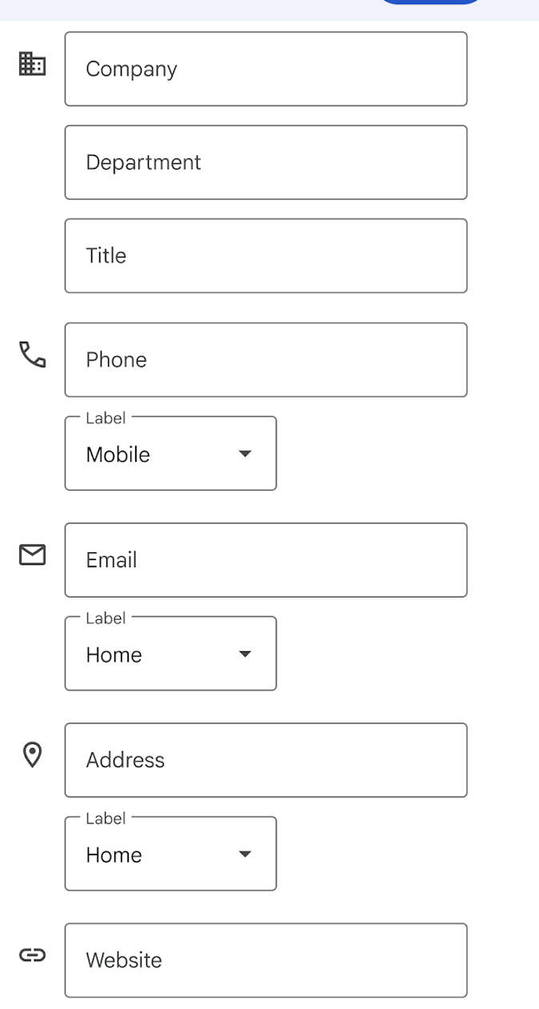
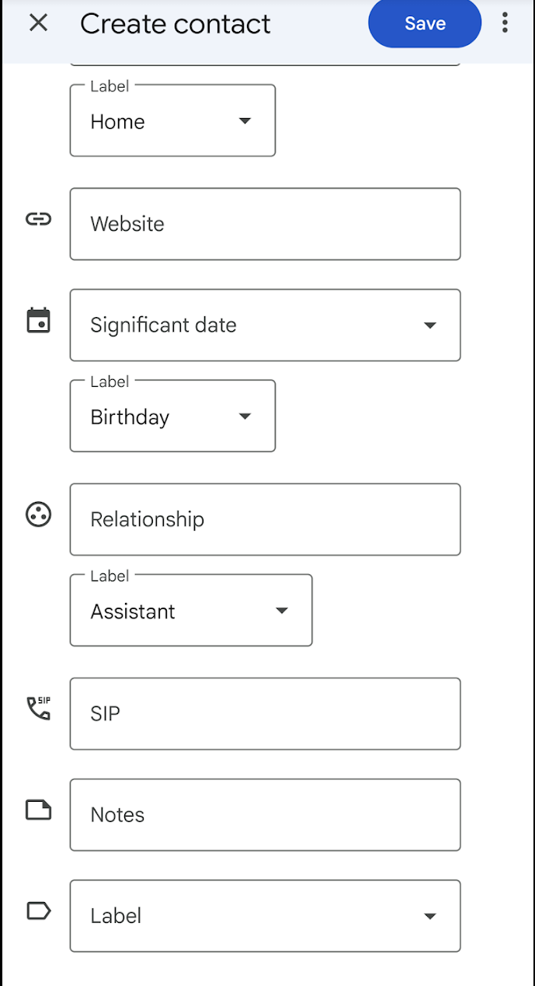
Notes:
https://www.dev2qa.com/android-contacts-database-structure/

Slide 7
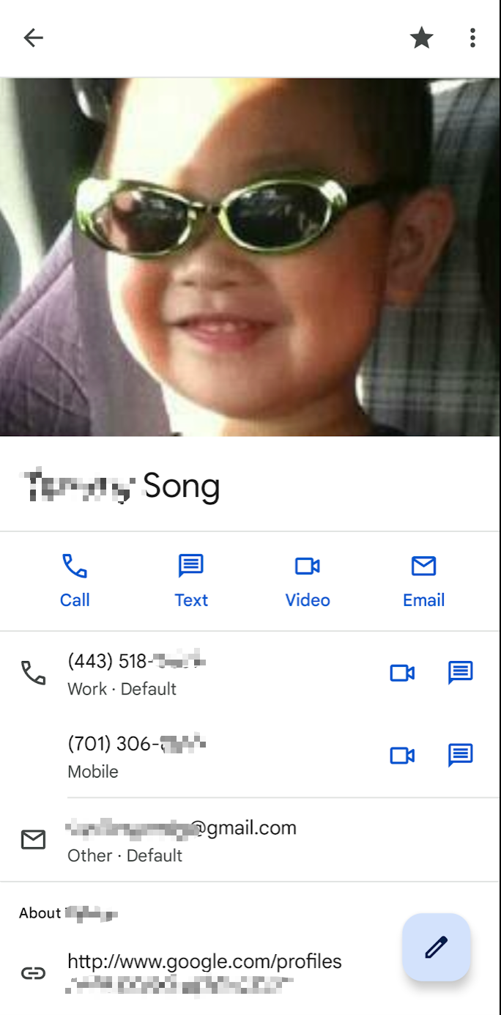
Sample questions
Owner contacts
How many contacts does the owner save?
What are the names of the groups?
Are there any groups marked as favourite?
Is there any description of any group?
Deleted contact
If the owner deleted some contacts, can we retrieve them?

Slide 8
Contacts Service Files Overview

Slide 9
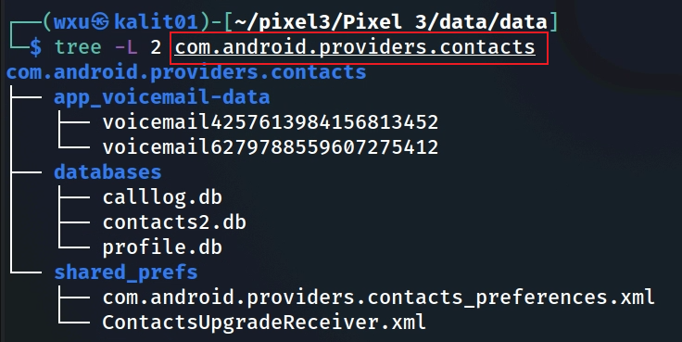
Contact management services files
Notes:
Cmd: sqlitebrowser 'Pixel 3/data/data/com.android.providers.contacts/databases/contacts2.db’
https://www.dev2qa.com/android-contacts-database-structure/

Slide 10
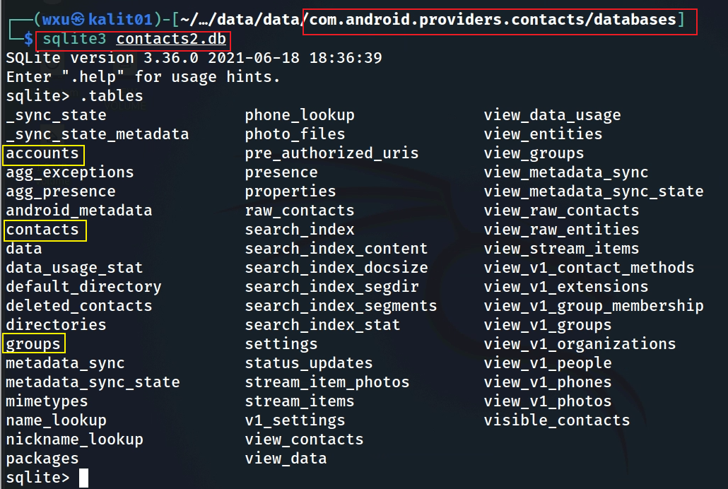
Tables in contacts.db
Notes:
The image shows the output of the `.tables` command on the `contacts2.db` SQLite database, which is used by Android's contacts provider (`com.android.providers.contacts`) to store contact-related data on a device like the Pixel 3. Below, I’ll explain the tables and views that are most valuable in a digital forensics context, focusing on those that provide meaningful user data or behavioral insights. I’ll rank them based on their forensic value, excluding tables or views that are less useful (e.g., internal metadata or search-index-related tables like `search_index_content`, `search_index_segdir`, etc., which are primarily for system optimization).
### Explanation and Ranking of Valuable Tables/Views for Digital Forensics
#### 1. **contacts** (High Value)
- **Explanation**: The `contacts` table stores core information about each contact on the device, such as the contact ID, display name, and whether the contact has been starred or pinned. It often links to other tables (like `raw_contacts`) for more detailed data.
- **Forensic Value**: This table provides a high-level overview of all contacts stored on the device, which is critical for identifying relationships, frequent contacts, or key individuals in an investigation. It’s often the starting point for mapping a user’s social network.
- **Rank**: 1st ( foundational for identifying contacts and linking to more detailed data).
#### 2. **raw_contacts** (High Value)
- **Explanation**: The `raw_contacts` table contains raw contact entries, which are tied to specific accounts (e.g., Google, WhatsApp). Each raw contact entry links to a contact in the `contacts` table but provides additional metadata, such as the source account, sync status, and whether the contact was deleted.
- **Forensic Value**: This table is crucial for understanding the origin of contacts (e.g., synced from Gmail vs. manually added) and tracking account-specific interactions. It can reveal which apps or services the user is using to manage contacts, offering insights into their digital footprint.
- **Rank**: 2nd (provides account-level context and sync details).
#### 3. **data** (High Value)
- **Explanation**: The `data` table stores detailed information about contacts, such as phone numbers, email addresses, physical addresses, and other structured data (e.g., birthdays, nicknames). Each row is linked to a `raw_contacts` entry and uses a `mimetype` to define the type of data (e.g., `vnd.android.cursor.item/phone_v2` for phone numbers).
- **Forensic Value**: This table is a goldmine for forensics because it contains the actual contact details that can be used to reconstruct communication networks, identify key contacts, or cross-reference with other evidence (e.g., call logs, emails). It can also reveal personal details about contacts that might be relevant to an investigation.
- **Rank**: 3rd (rich in detailed contact information, though requires linking to `raw_contacts` for context).
#### 4. **groups** (Moderate to High Value)
- **Explanation**: The `groups` table stores information about contact groups (e.g., "Family," "Work," "Friends") created by the user. It includes group IDs, names, and metadata about the group’s visibility or sync status.
- **Forensic Value**: This table can reveal how the user organizes their contacts, which can provide behavioral insights (e.g., a group named "Suspects" or "Clients" might be relevant in a criminal or business investigation). It can also help identify clusters of related contacts.
- **Rank**: 4th (valuable for behavioral analysis and grouping, but less detailed than `data`).
#### 5. **phone_lookup** (Moderate Value)
- **Explanation**: The `phone_lookup` table is an index that maps phone numbers to contact IDs, optimized for quick lookups during calls or messaging.
- **Forensic Value**: This table is useful for cross-referencing phone numbers found in other evidence (e.g., call logs, SMS) with contacts on the device. It can help confirm whether a number belongs to a known contact, which is valuable for linking communications to specific individuals.
- **Rank**: 5th (helpful for mapping numbers to contacts, but less detailed than primary tables).
#### 6. **status_updates** (Moderate Value)
- **Explanation**: The `status_updates` table stores status updates for contacts, typically from social or messaging apps integrated with the contacts provider (e.g., WhatsApp status or Google Talk presence).
- **Forensic Value**: This table can provide insights into a user’s social interactions and the activity of their contacts (e.g., when a contact was last online). It’s particularly useful if the user is using apps that integrate status updates with the contacts system, offering a timeline of activity.
- **Rank**: 6th (useful for social activity tracking, but depends on app integration).
#### 7. **view_data** (Moderate Value)
- **Explanation**: The `view_data` view is a virtual table that combines data from the `data` table with other metadata, making it easier to query structured contact information (e.g., phone numbers, emails) in a more user-friendly format.
- **Forensic Value**: This view simplifies access to contact details, making it easier to extract actionable data without complex joins. It’s essentially a pre-joined version of the `data` table, so its forensic value overlaps with `data` but is more convenient for quick analysis.
- **Rank**: 7th (convenient for querying, but redundant with `data`).
#### 8. **accounts** (Moderate Value)
- **Explanation**: The `accounts` table lists the accounts synced with the device (e.g., Google, Samsung) that contribute to the contacts database. It includes account names and types.
- **Forensic Value**: This table helps identify which accounts are linked to the device, which can point investigators to other sources of evidence (e.g., Gmail, cloud backups). It also shows the scope of contact syncing, which can reveal the user’s digital ecosystem.
- **Rank**: 8th (useful for identifying linked accounts, but less directly tied to user behavior).
### Tables/Views Excluded (Low Forensic Value)
I’ve excluded tables like `search_index_*` (e.g., `search_index_content`, `search_index_segdir`), `android_metadata`, `sync_state`, `properties`, and others because they are primarily for system optimization, indexing, or internal bookkeeping. For example:
- `search_index_*` tables are for full-text search functionality and don’t contain user-facing data.
- `android_metadata` stores database versioning info (e.g., locale).
- `sync_state` and related tables manage synchronization metadata, which is less relevant unless investigating specific sync issues.
### Summary of Rankings
1. **contacts**: Core contact list, starting point for relationships.
2. **raw_contacts**: Links contacts to accounts, revealing sources.
3. **data**: Detailed contact info (phone, email, etc.).
4. **groups**: Shows user-defined contact organization.
5. **phone_lookup**: Maps numbers to contacts for cross-referencing.
6. **status_updates**: Tracks social activity via status updates.
7. **view_data**: Simplified access to contact details.
8. **accounts**: Identifies synced accounts for broader context.
These tables and views provide the most actionable data for digital forensics, focusing on user relationships, communication details, and behavioral patterns.

Slide 11
Summary of key tables
accounts: Identifies synced accounts.
contacts: Contacts metadata
raw_contacts: Individual contact entries tied to specific accounts (e.g., Google, WhatsApp)
data: Detailed and actual contact info (phone, email, etc.).
groups: Shows user-defined contact organization.
phone_lookup: Maps numbers to contacts for cross-referencing.
status_updates: Tracks social activity via status updates.
view_data: Simplified access to contact details.

Slide 12
accounts table
Explanation: stores app accounts associated with the contacts on the device, allowing the system to manage contacts from multiple sources (e.g., Google, WhatsApp, or other apps)
not contain detailed contact data; you’d need to cross-reference with tables like "raw_contacts" or "data" for more information
Forensic Value: It reveals the accounts linked to the device, which can help identify the device owner or users (e.g., email addresses or app-specific accounts). It shows where contacts are sourced from (e.g., Google, WhatsApp), which can indicate the user’s communication platforms.

Slide 13
raw_contacts table
Explanation: The raw_contacts table contains raw contact entries which are tied to specific accounts (e.g., Google, WhatsApp). Each raw contact entry links to a contact in the contacts table but provides additional metadata, such as the source account, sync status, and whether the contact was deleted. It includes display name.
Forensic Value: This table is crucial for understanding the origin of contacts (e.g., synced from Gmail vs. manually added) and tracking account-specific interactions. It can reveal which apps or services the user is using to manage contacts, offering insights into their digital footprint.

Slide 14
contacts table
Explanation: The contacts table stores meta information about each contact on the device, such as the contact ID and whether the contact has been starred or pinned. It often links to other tables (like raw_contacts) for more detailed contact data.
Forensic Value: This table provides a high-level overview of all contacts stored on the device, which is critical for identifying relationships, frequent contacts, or key individuals in an investigation. It’s often the starting point for mapping a user’s social network.

Slide 15
data table
Explanation: The data table stores actual detailed information about contacts, such as phone numbers, email addresses, physical addresses, and other structured data (e.g., birthdays, nicknames). Each row is linked to a raw_contacts entry and uses a mimetype to define the type of data (e.g., vnd.android.cursor.item/phone_v2 for phone numbers).
Forensic Value: This table is a goldmine for forensics because it contains the actual contact details that can be used to reconstruct communication networks, identify key contacts, or cross-reference with other evidence (e.g., call logs, emails). It can also reveal personal details about contacts that might be relevant to an investigation.

Slide 16
groups table
Explanation: The groups table stores information about contact groups (e.g., "Family," "Work," "Friends") created by the user. It includes group IDs, names, and metadata about the group’s visibility or sync status.
Forensic Value: This table can reveal how the user organizes their contacts, which can provide behavioral insights (e.g., a group named "Suspects" or "Clients" might be relevant in a criminal or business investigation). It can also help identify clusters of related contacts.

Slide 17
phone_lookup table
Explanation: The phone_lookup table is an index that maps phone numbers to contact IDs, optimized for quick lookups during calls or messaging.
Forensic Value: This table is useful for cross-referencing phone numbers found in other evidence (e.g., call logs, SMS) with contacts on the device. It can help confirm whether a number belongs to a known contact, which is valuable for linking communications to specific individuals.

Slide 18
status_updates table
Explanation: The status_updates table stores status updates for contacts, typically from social or messaging apps integrated with the contacts provider (e.g., WhatsApp status or Google Talk presence).
Forensic Value: This table can provide insights into a user’s social interactions and the activity of their contacts (e.g., when a contact was last online). It’s particularly useful if the user is using apps that integrate status updates with the contacts system, offering a timeline of activity.

Slide 19
raw_contacts vs. contacts tables
The raw_contacts table stores individual contact entries tied to specific accounts (e.g., Google, WhatsApp)
The contacts table aggregates these raw contact entries into unified contacts that the user sees in the Contacts app.
For example, if "John Doe" has a Google contact and a WhatsApp contact, there will be two rows in raw_contacts, but they might be merged into one entry in the contacts table.

Slide 20
accounts table

Slide 21
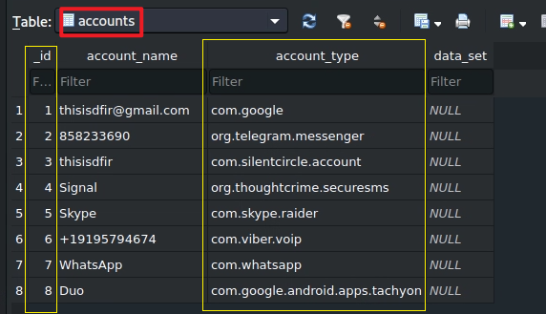
accounts table structure
_id: A unique identifier for each account entry (e.g., 1, 2, 3, etc.).
account_name: The name or identifier of the account (e.g., an email address, phone number, or app-specific identifier).
account_type: The type of account, typically in the format of a package name (e.g., com.google, com.whatsapp), indicating the app or service the account belongs to.
data_set: Additional data specific to the account type (in this case, all entries are NULL, meaning no extra data is stored here).

Slide 22
rwo_contacts table

Slide 23
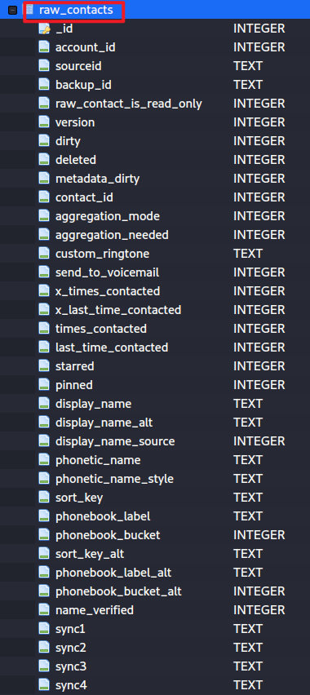
Valuable columns in raw_contacts table
contact_id: Links to the contacts table for aggregation and further data retrieval.
last_time_contacted: Establishes a timeline of interactions.
times_contacted: Indicates frequency of interaction.
account_id: Reveals the contact’s source account, pointing to the user’s digital ecosystem.
display_name: Shows the contact’s name as provided by the source account.
starred: Highlights favorite contacts.
pinned: Indicates frequently accessed contacts.
send_to_voicemail: Suggests user behavior toward the contact.
custom_ringtone: Provides insight into contact significance.
deleted: Identifies potentially hidden or removed contacts.

Slide 24
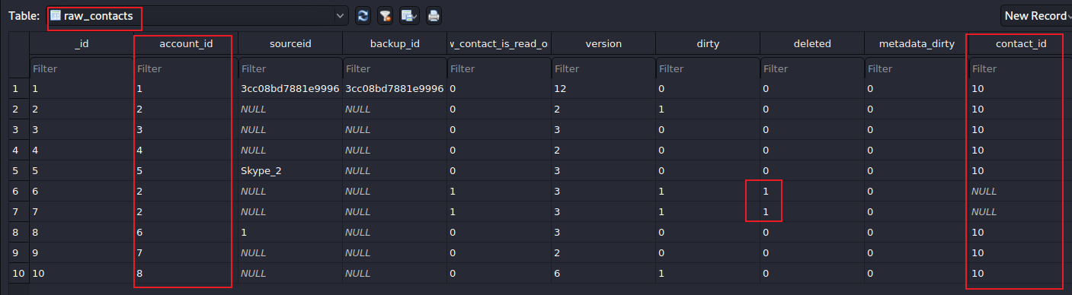


Join contacts with accounts tables
_id | account_name | account_type
telegram saved three contacts; two of them are deleted
Find the number of contact_id

Slide 25
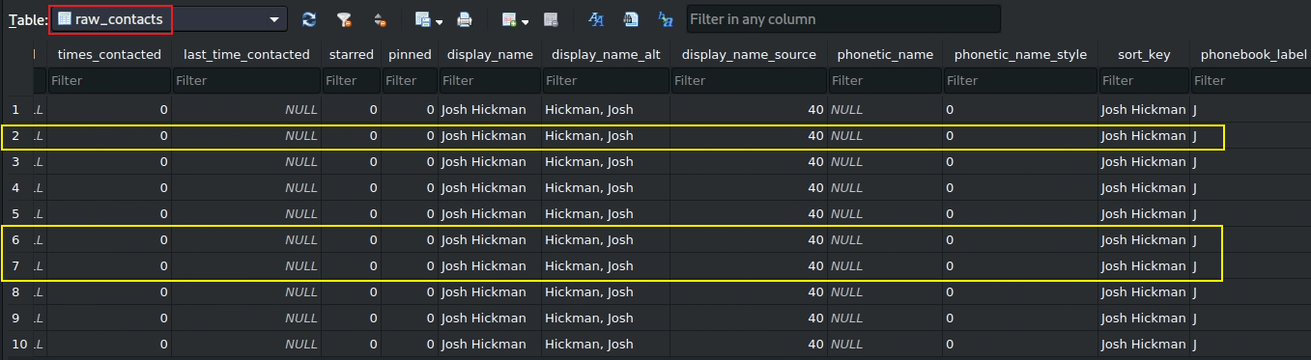
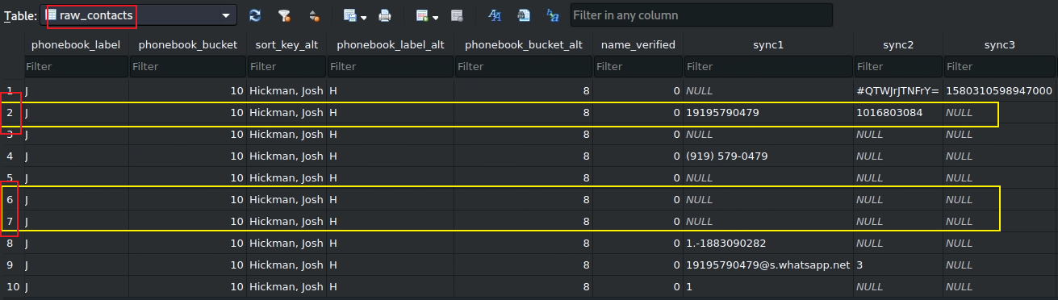

Slide 26
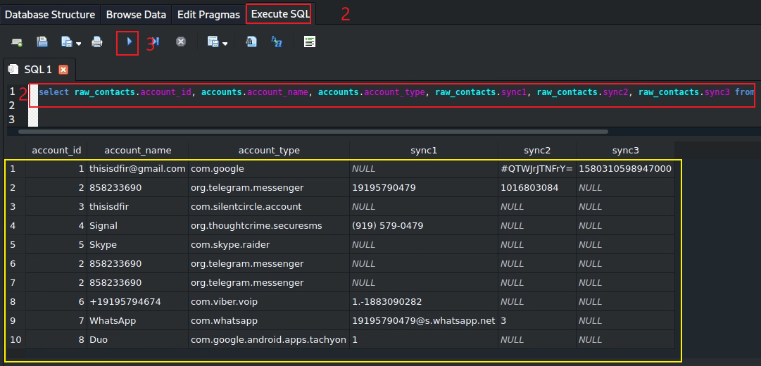

Results of joining raw_contacts with accounts
select raw_contacts.account_id, accounts.account_name, accounts.account_type, raw_contacts.sync1, raw_contacts.sync2, raw_contacts.sync3 from raw_contacts INNER join accounts WHERE raw_contacts.account_id= accounts._id;
Notes:
select raw_contacts.account_id, accounts.account_name, accounts.account_type from raw_contacts INNER join accounts WHERE raw_contacts.account_id= accounts._id;

Slide 27
All raw contacts belong to one person in the device
raws in contact_id=10 will be aggregated to id=10 in contact table

Slide 28
contacts table

Slide 29
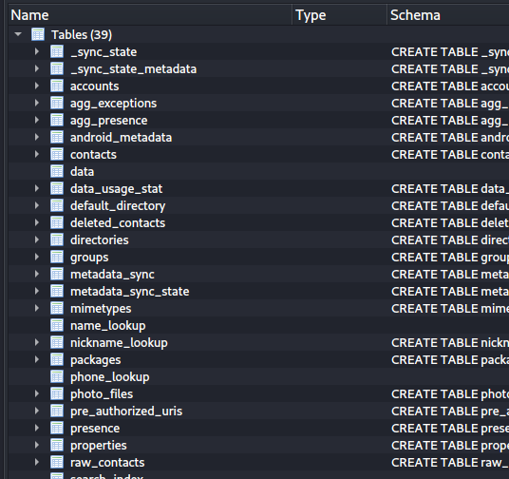
metadata of each contacts info, e.g., times contacted, last time contacted
contacts info
fields of contacts
contact group information, e.g., family, friends
raw data is unprocessed data, which contains contacts from difference accounts
Notes:
Cmd: sqlitebrowser 'Pixel 3/data/data/com.android.providers.contacts/databases/contacts2.db’
https://www.dev2qa.com/android-contacts-database-structure/

Slide 30
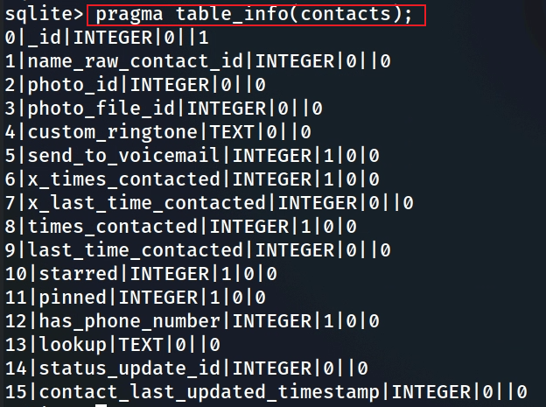
contacts table schema and key columns
_id: This contact’s unique ID, which can be used to link to other tables (e.g., raw_contacts, data).
new_raw_contact_id: ?
last_time_contacted: Establishes a timeline of interactions.
contact_last_updated_timestamp: Shows when the contact was last modified.
starred and pinned: Indicate important contacts.
has_phone_number: Filters contacts with communication potential.
Notes:
The image shows the output of the SQLite command `pragma table_info(contacts);`, which provides the schema (structure) of the `contacts` table in the `contacts2.db` database. This table is part of Android's contacts provider system, used to store core information about contacts on a device like the Pixel 3. Below, I’ll explain each column in the `contacts` table, including its data type, constraints, and purpose, with a focus on its relevance in a digital forensics context.
### Explanation of Columns in the `contacts` Table
1. **_id** (INTEGER, NOT NULL, Primary Key)
- **Explanation**: This is the unique identifier for each contact entry in the table. It’s an auto-incrementing integer that serves as the primary key.
- **Purpose**: Used to uniquely identify a contact and link to related data in other tables (e.g., `raw_contacts`, `data`).
- **Forensic Value**: Essential for mapping relationships between tables. For example, you can use `_id` to find all phone numbers for a contact in the `data` table.
2. **name_raw_contact_id** (INTEGER, NULL, Default: 0)
- **Explanation**: This column stores the ID of the `raw_contacts` entry that provides the display name for this contact. A single contact in the `contacts` table can aggregate multiple `raw_contacts` entries (e.g., one from Google, one from WhatsApp), and this points to the primary one used for the name.
- **Purpose**: Links the contact to its primary raw contact for naming purposes.
- **Forensic Value**: Useful for tracing the source of a contact’s display name and understanding how contacts are aggregated across accounts.
3. **photo_id** (INTEGER, NULL, Default: 0)
- **Explanation**: This column stores the ID of the contact’s photo, if one exists, linking to a photo stored elsewhere (e.g., in the `data` table or a file system).
- **Purpose**: Associates a contact with a profile picture.
- **Forensic Value**: Can be used to retrieve a contact’s photo, which might be relevant for identification or visual confirmation in an investigation.
4. **photo_file_id** (INTEGER, NULL, Default: 0)
- **Explanation**: This column stores the ID of the file containing the contact’s photo, typically used for high-resolution images stored separately.
- **Purpose**: Provides a reference to the actual photo file, as opposed to `photo_id`, which might point to a thumbnail.
- **Forensic Value**: Similar to `photo_id`, it helps retrieve a contact’s photo, potentially offering higher-quality images for forensic analysis.
5. **custom_ringtone** (TEXT, NULL, Default: 0)
- **Explanation**: This column stores the URI (as text) of a custom ringtone assigned to the contact, if any.
- **Purpose**: Allows the user to set a specific ringtone for a contact, which plays when they call.
- **Forensic Value**: Indicates user customization, which can provide behavioral insights (e.g., a unique ringtone might suggest a significant contact, like a family member or close associate).
6. **send_to_voicemail** (INTEGER, NOT NULL, Default: 0)
- **Explanation**: A boolean flag (0 or 1) indicating whether calls from this contact should be sent directly to voicemail.
- **Purpose**: Used to manage call handling for specific contacts.
- **Forensic Value**: Can reveal the user’s relationship with the contact (e.g., sending calls to voicemail might indicate avoidance or a strained relationship).
7. **x_times_contacted** (INTEGER, NOT NULL, Default: 0)
- **Explanation**: This column tracks the number of times the user has initiated contact with this person (e.g., via calls or messages). Note: This field is deprecated in newer Android versions and may not be updated.
- **Purpose**: Historically used to rank contacts by frequency of interaction.
- **Forensic Value**: If populated, it can indicate the frequency of interaction, helping identify key contacts. However, its reliability depends on the Android version and usage.
8. **x_last_time_contacted** (INTEGER, NOT NULL, Default: 0)
- **Explanation**: Stores a timestamp (in milliseconds since epoch) of the last time the user initiated contact with this person. Like `x_times_contacted`, this field is deprecated.
- **Purpose**: Tracks the most recent interaction for ranking or display purposes.
- **Forensic Value**: If populated, it provides a timeline of interactions, which is valuable for establishing communication patterns. Its usefulness is limited if the field isn’t updated.
9. **last_time_contacted** (INTEGER, NULL, Default: 0)
- **Explanation**: Stores a timestamp (in milliseconds since epoch) of the last time the contact was interacted with (e.g., called, messaged). Unlike `x_last_time_contacted`, this field is still used in modern Android versions.
- **Purpose**: Tracks recent interactions for contact management and display.
- **Forensic Value**: Highly valuable for establishing a timeline of communication. It can help pinpoint when the user last interacted with a contact, which is critical in investigations.
10. **starred** (INTEGER, NOT NULL, Default: 0)
- **Explanation**: A boolean flag (0 or 1) indicating whether the contact is marked as a favorite (starred).
- **Purpose**: Allows users to mark important contacts for quick access.
- **Forensic Value**: Indicates the user’s prioritization of contacts, which can highlight significant relationships (e.g., a starred contact might be a close friend, family member, or key associate).
11. **pinned** (INTEGER, NOT NULL, Default: 0)
- **Explanation**: A boolean flag (0 or 1) indicating whether the contact is pinned to the top of the contact list.
- **Purpose**: Used for UI purposes to keep frequently accessed contacts at the top.
- **Forensic Value**: Similar to `starred`, it shows user prioritization, providing insight into important relationships.
12. **has_phone_number** (INTEGER, NOT NULL, Default: 0)
- **Explanation**: A boolean flag (0 or 1) indicating whether the contact has at least one phone number associated with them.
- **Purpose**: Used for quick filtering in the UI (e.g., to show only contacts with phone numbers in the dialer).
- **Forensic Value**: Helps identify contacts that can be called or messaged, which is useful for focusing on communication-related evidence.
13. **lookup** (TEXT, NULL, Default: 0)
- **Explanation**: Stores a lookup key (a unique string) used to identify the contact across apps and sync operations. It’s typically a combination of the contact’s ID and other data.
- **Purpose**: Ensures consistent identification of a contact, even if the `_id` changes (e.g., after a sync or restore).
- **Forensic Value**: Useful for tracking a contact across different systems or backups, ensuring continuity in an investigation.
14. **status_update_id** (INTEGER, NULL, Default: 0)
- **Explanation**: Links to an entry in the `status_updates` table, which stores status updates for the contact (e.g., from social apps like WhatsApp or Google Talk).
- **Purpose**: Associates a contact with their latest status update.
- **Forensic Value**: Can provide social activity insights, such as the contact’s last known status, which might indicate their availability or activity at a specific time.
15. **contact_last_updated_timestamp** (INTEGER, NULL, Default: 0)
- **Explanation**: Stores a timestamp (in milliseconds since epoch) of the last time the contact’s data was updated (e.g., when a phone number was added or the name was changed).
- **Purpose**: Tracks when the contact entry was last modified.
- **Forensic Value**: Critical for establishing a timeline of changes to the contact. It can help determine when a contact was added or modified, which might correlate with key events in an investigation.
### Summary of Forensic Relevance
- **High-Value Columns**:
- `last_time_contacted`: Establishes a timeline of interactions.
- `contact_last_updated_timestamp`: Shows when the contact was last modified.
- `_id`: Links to other tables for detailed data (e.g., phone numbers in `data`).
- `starred` and `pinned`: Indicate important contacts.
- `has_phone_number`: Filters contacts with communication potential.
- **Moderate-Value Columns**:
- `name_raw_contact_id`: Links to the source of the contact’s name.
- `status_update_id`: Provides social activity insights.
- `send_to_voicemail`: Reveals user behavior toward the contact.
- `custom_ringtone`: Indicates customization and potential significance.
- **Lower-Value Columns**:
- `photo_id`, `photo_file_id`: Useful for visual identification but less critical.
- `x_times_contacted`, `x_last_time_contacted`: Deprecated and often unreliable.
- `lookup`: More technical, useful for cross-system tracking but not direct evidence.
The `contacts` table serves as a foundational table in the `contacts2.db` database, linking to other tables like `raw_contacts` and `data` for more detailed information. In a forensic investigation, columns like `last_time_contacted` and `contact_last_updated_timestamp` are particularly valuable for timeline analysis, while `starred` and `pinned` help identify key relationships.

Slide 31






Show rows in contacts table
_id: 10 This contact’s unique ID is 10, which can be used to link to other tables (e.g., contacts’ _id in raw_contacts). This is the aggregation of multiple rows in raw_contacts.
contacts
_id
contact_lasttime_updated
raw_contacts
account_id (e.g., whatsapp)
contact_id
Display_name
Account_id
accounts
_id
1:n
n:1

Slide 32
(Alternative) Using sqlitebrowser
Exam contacts table

Slide 33
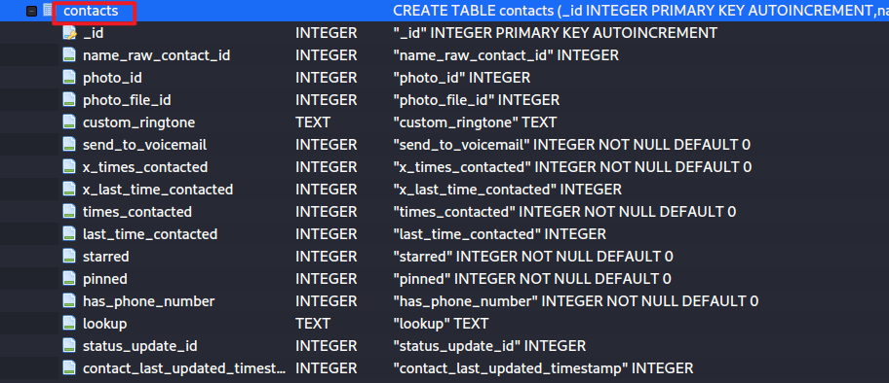
(Alternative)
The last time this contact is contacted. The format is in milliseconds.
The timestamp this contact is updated for the last time.
contact id

Slide 34
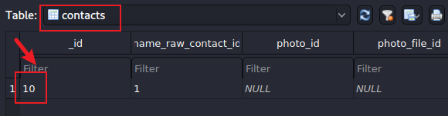
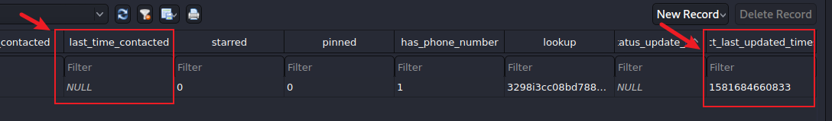
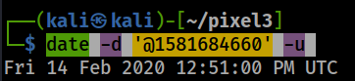
(Alternative) Show rows in contacts table
Notes:
date -d '@1581684660' -u

Slide 35
data table
contain actual contact information

Slide 36



Link data to raw_contacts table
data
raw_contact_id (10)
data1
data..
datan
n
:
1
contacts
_id (10)
contact_lasttime_updated
raw_contacts
account_id (e.g., whatsapp)
contact_id
Display_name
accounts
_id
1:n
n:1

Slide 37
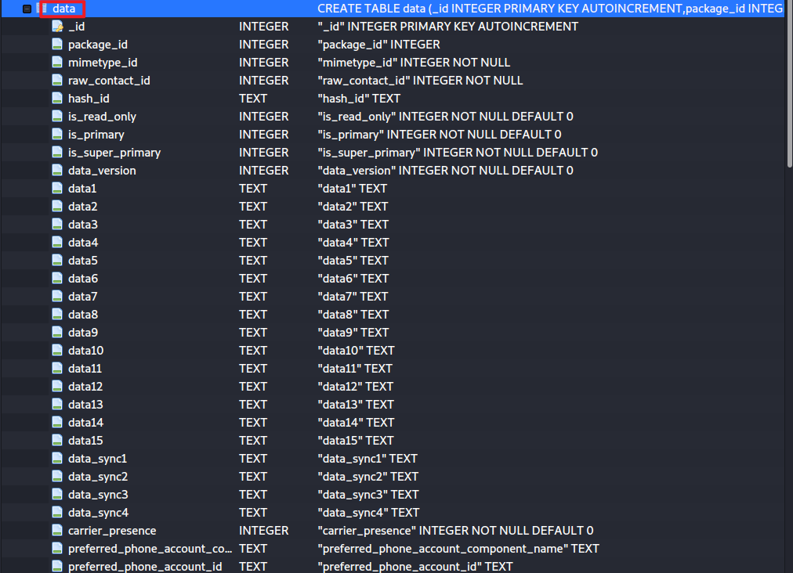
What are the details of the contact with ID 10?
Show data table structure
contact details are saved in data table

Slide 38
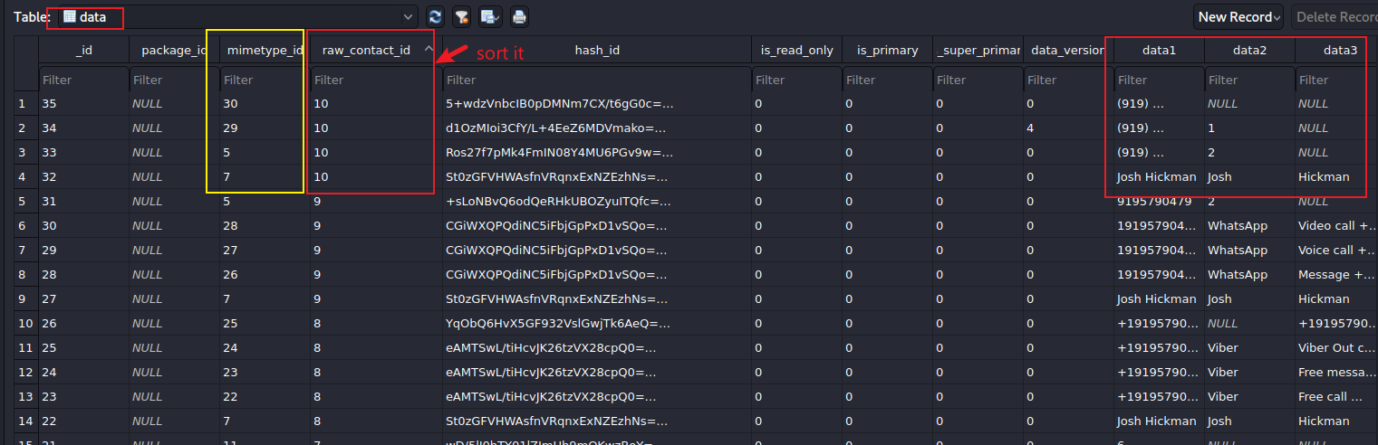
indicate what data type is stored in this row.
See mimetypes Table
indicate the data for the data type
contact 10 (has four fields, each field has a different value type based on minetypes)
Show content of data table

Slide 39
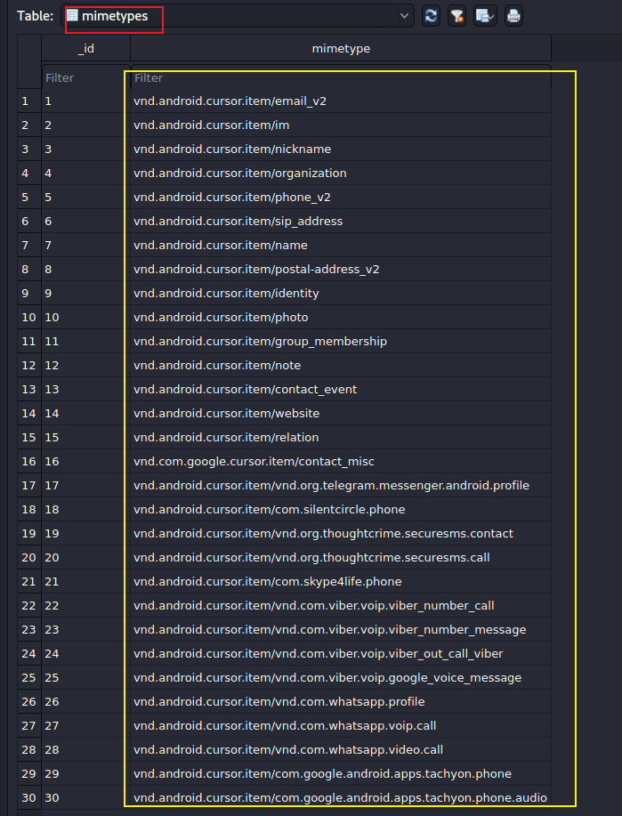
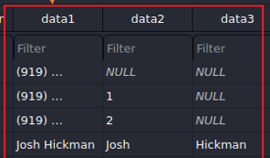
Show structure of minetypes
Used to define android contact filed mime type. For example, for the contact information email field, it’s mimetype is vnd.android.cursor.item/email_v2.
The contact includes phone number, name, …, ….
google FI

Slide 40
When a new raw_contact is added to raw_contacts table

Slide 41
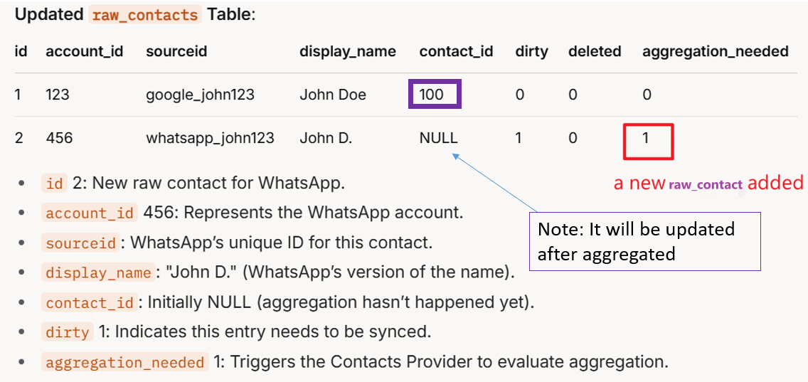

Slide 42
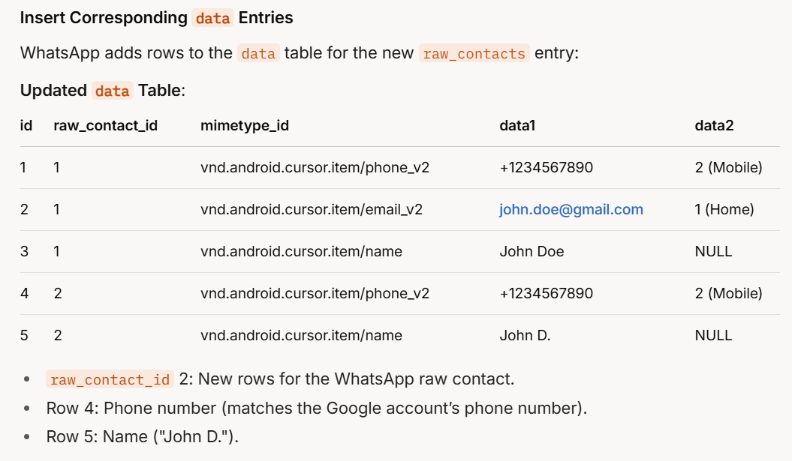
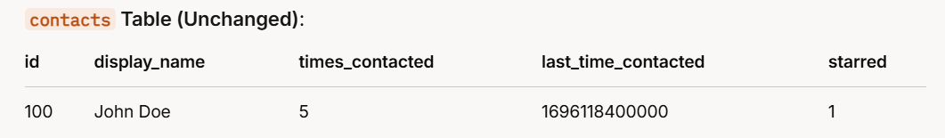



added

Slide 43
groups table

Slide 44
How many groups have the device owner create?
Before adding any contact in android, you can create a new group or select an existing contact group.
Exam contact group information, e.g., family, friends

Slide 45
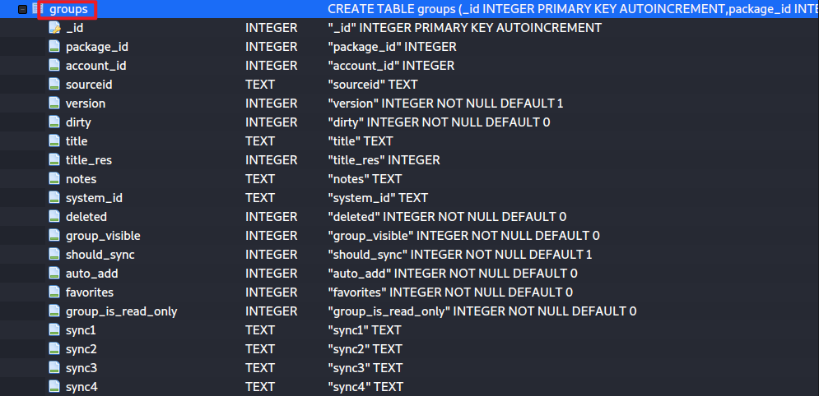
Show group table schema
group description info.

Slide 46
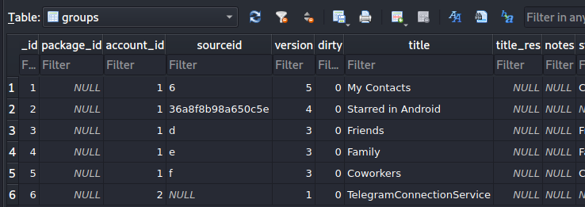
Show 6 groups and the names of the groups
Can you list all contacts in each group?

Slide 47
Investigating calllog.db

Slide 48
A simple calling scenario
A call from +19195121037 was made to the device owner on Feb 12, 2020
Questions need to be answered during the investigation
What is the approximate time the call was made?
Did the receiver answer the call?
What was the duration of the call if answered?

Slide 49
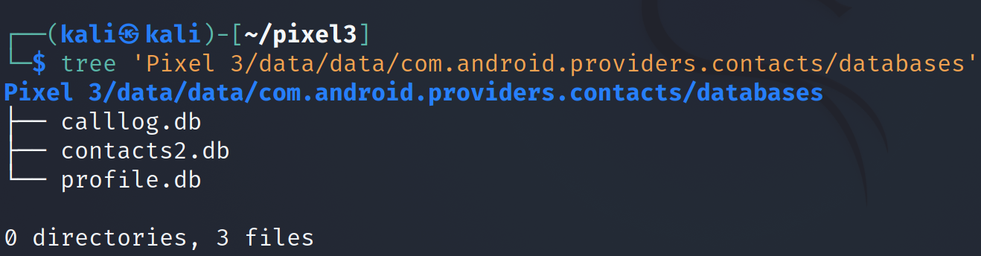
Find the database location
Notes:
Cmd: tree 'Pixel 3/data/data/com.android.providers.contacts/databases'

Slide 50
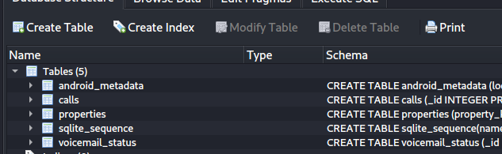
Show all tables in the database
calls: call log
Contains made/received calls along with timestamp and duration

Slide 51
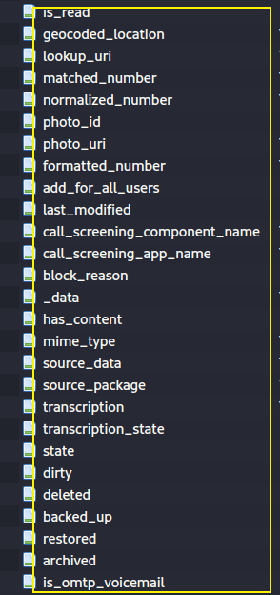
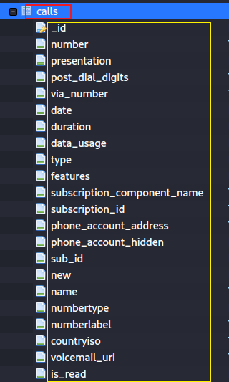
incoming/ outgoing number
if show phone number
Date/time when call was made/received
INCOMING_TYPE
OUTGOING_TYPE
MISSED_TYPE
VOICEMAIL_TYPE
REJECTED_TYPE
BLOCKED_TYPE
ANSWERED_EXTERNALLY_TYPE
phone account id
If it left voicemail, then url to the voice

Slide 52
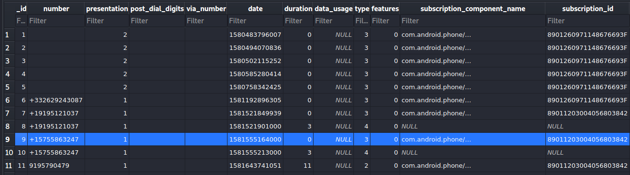
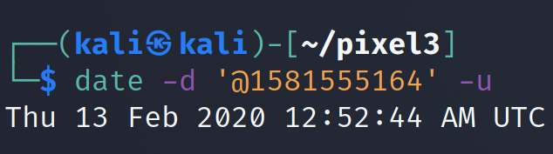
Exam calls table
incoming/ outgoing number
Date/time when call was made/received
missed call
record _id=10 are voicemail type after missed the call (record 9)
Duration of the call
Notes:
https://developer.android.com/reference/android/provider/CallLog.Calls

Slide 53
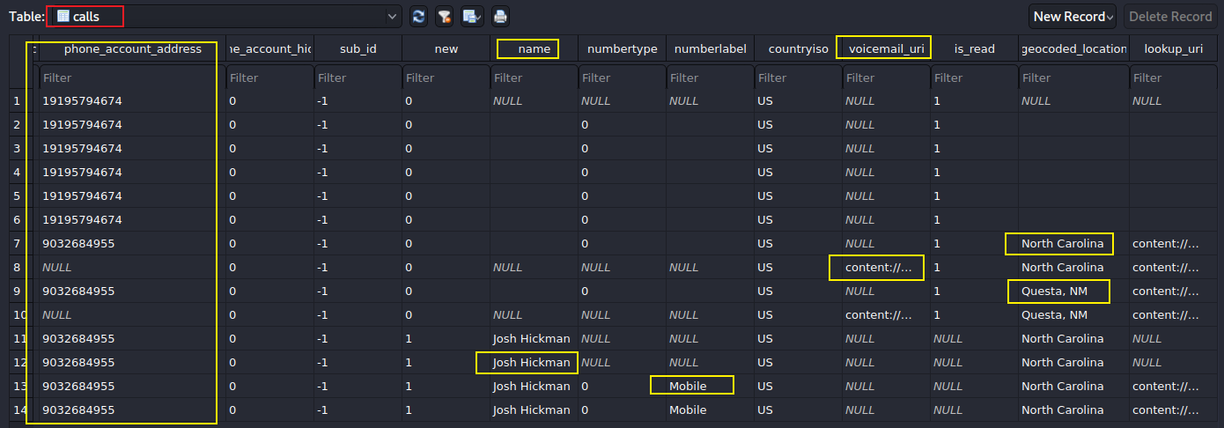

Slide 54
Calling logs investigation solutions
What is the exact time the call was made?
The call was made on Feb 12, 2020 around 04:00:00 pm
Did the receiver answer the call?
No, because it is a missed call.
If the call was answered, how long the conversation last?
A missed call, 0 second
Where is the caller located?
Questa, MN

Slide 55
Investigating Voicemails (part of call logs)

Slide 56
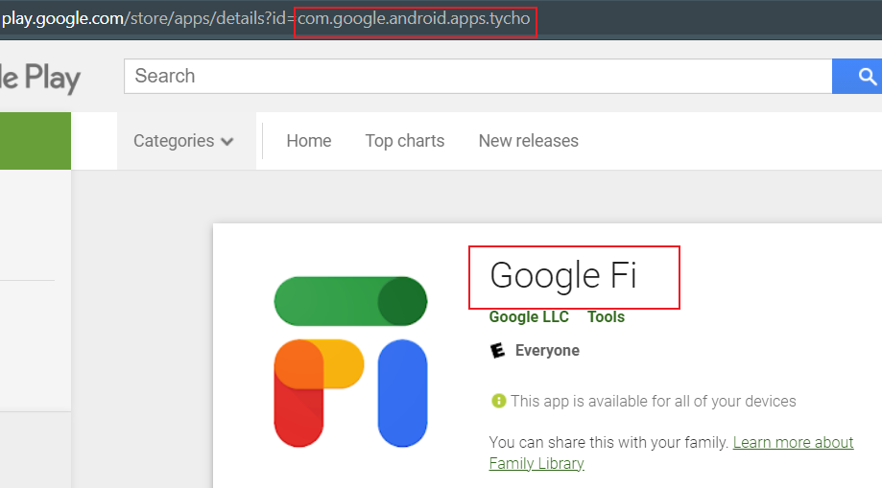
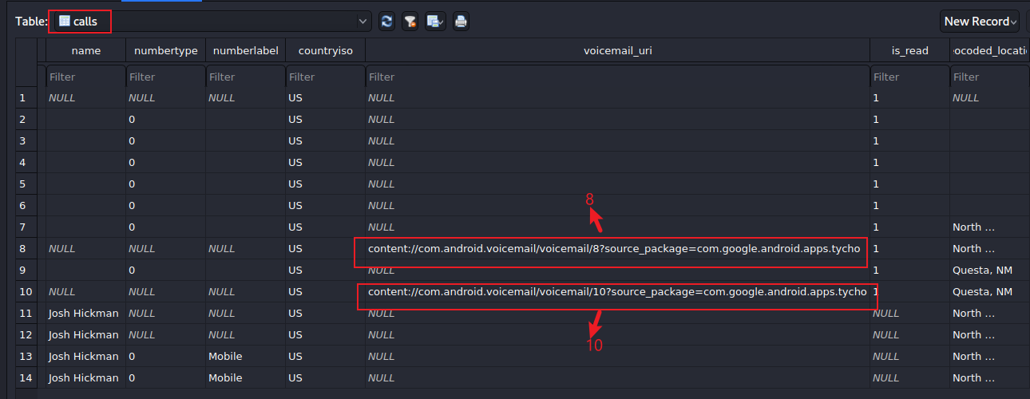
What is the saved voicemail url?
the owner use Google FI and it provides voicemail
Find which service provides voicemail

Slide 57
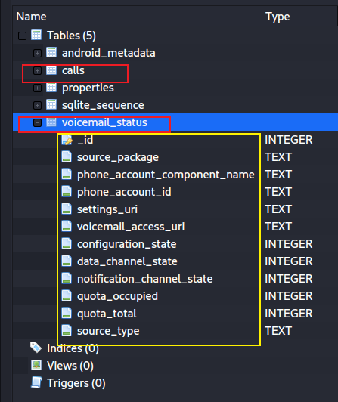
How to access voicemail?
App used by caller, Google dialer
voicemail_access_url

Slide 58
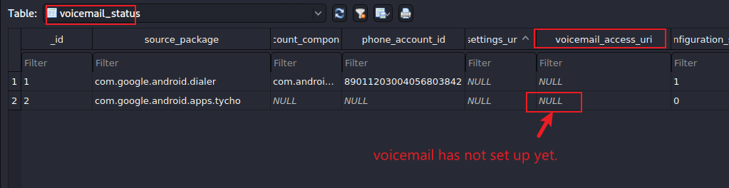
Find voicemail access url

